Slide 1
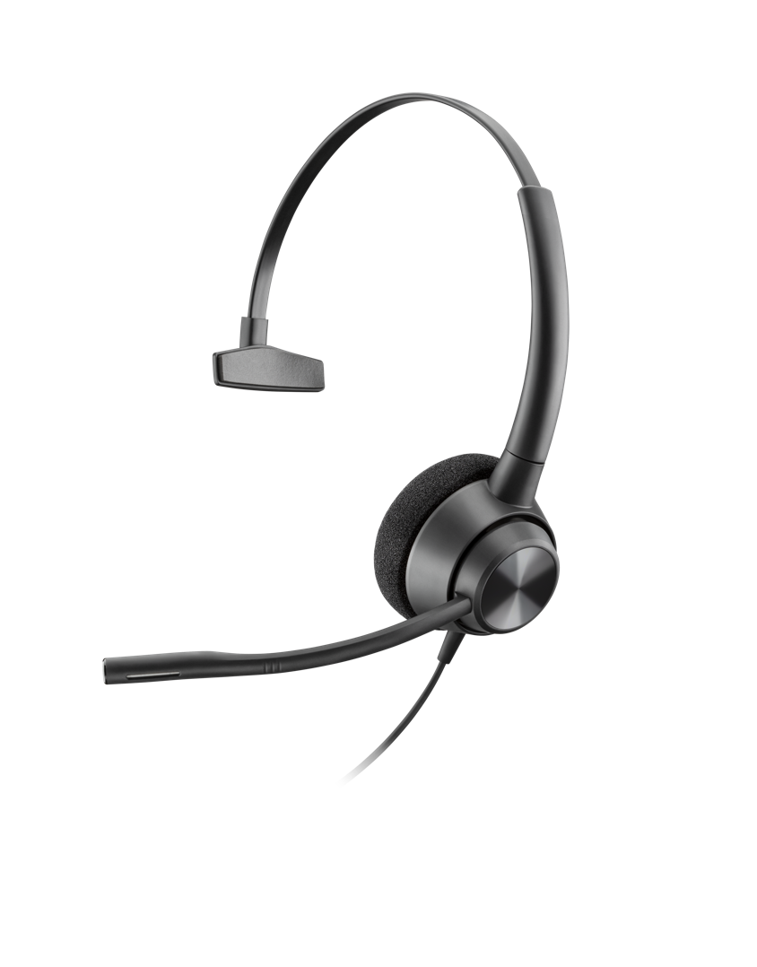
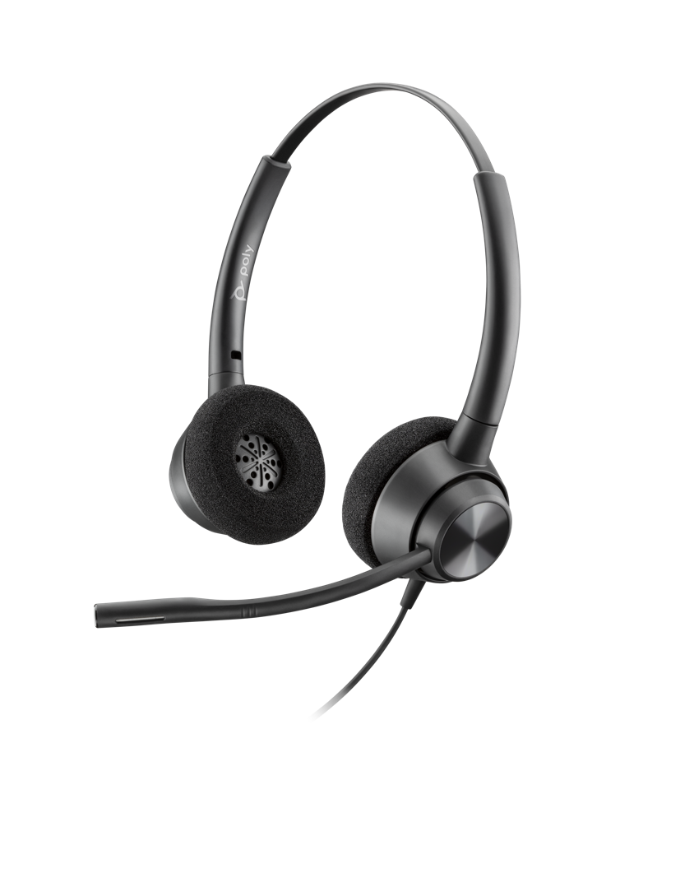
EncorePro 300 series
Notes:
Welcome, thank you for your time. This is an overview of our EncorePro 300 series of headsets.

Slide 2
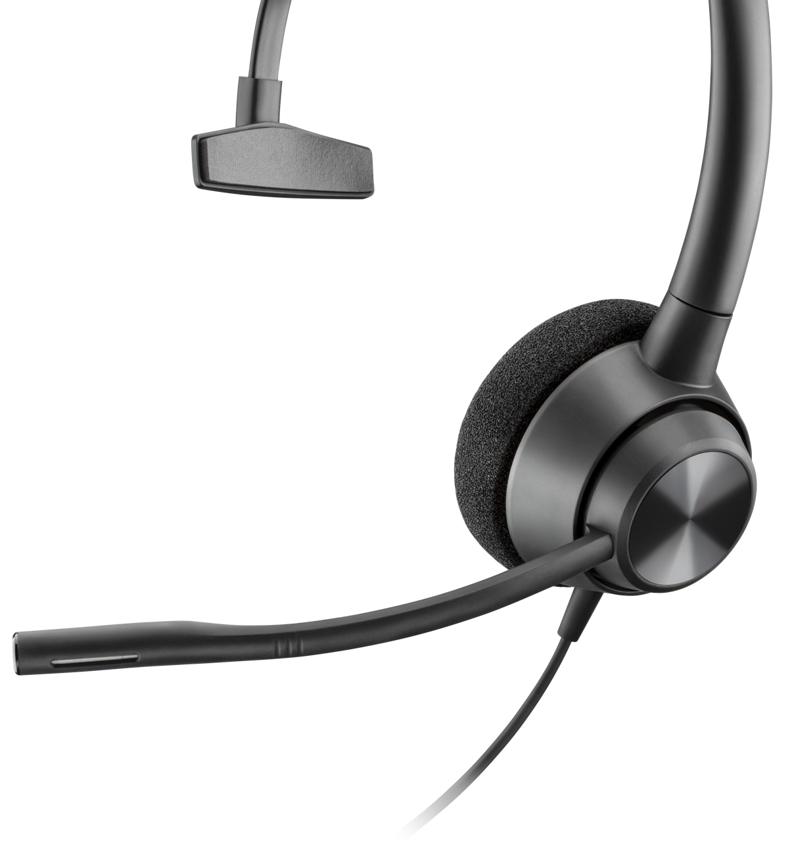
New EncorePro 300 Series
Value headsets for the cost sensitive contact center
According to leading industry experts the growth in DECTTM is largely due to users’ need for multi-device connectivity options
Users need to connect and communicate with multiple devices and want the option of a wireless headset
Notes:
The EncorePro 300 occupies a new place in our family of contact center headsets – it is designed for those customers who are highly cost sensitive, and have not been able to access the benefits of a Poly headset before.

Slide 3
Global Customer Experience trends
Legacy transition to cloud
Challenges
Aligning to the right vendor
Technology and deployment model (full cloud, hybrid, etc.) to reduce risk
Omnichannel & AI augmented experiences
Challenges
Selecting right channel mix
Building agent talent pool
Measuring success and ROI across channels
Changing agent landscape
Challenges
Getting key info to agents in a timely manner
Procuring professional endpoints for softphone connectivity
Notes:
Three Major Trends in the Contact Center. These are the challenges our customers are facing that we can help them solve.
Align Poly solutions to each trend:
Legacy Transition to the Cloud – The EncorePro 300 comes in QD versions to work with our multi-connect adapters. This helps you preserve investment in your contact center devices. If you have already moved to cloud, dedicated USB versions of the headsets are available
Omnichannel & AI – Customer service is complex, hence AI is gaining importance to help agents deliver better experiences. The EncorePro 300 series works seamlessly with ManagerPro to deliver insight into calls that can build your knowledge base ready for AI
Changing Agent Landscape – The role of the agent in your organization is elevating, they are now the voice of your brand. It’s time to get them the headsets they deserve

Slide 4
The voice channel is not going away
Source: Frost & Sullivan, 2018
*Zendesk 2018 Customer Experience Trends
ONLY 4% said voice decreased last year*
70% said voice calls increased
Consistent research shows voice channel has higher satisfaction
Notes:
Contrary to popular belief that Self Service would ultimately eliminate the need for Voice, the opposite is occurring. A recent Frost and Sullivan survey of those who deployed self service options showed that the number of and duration of Voice calls actually increased as reflected in the charts. 96% of those surveyed by Frost & Sullivan said the number of Voice calls handled either remained the same or increased. The average talk time also increased as the type of calls handled were more sensitive and complex that those handled by self service.
In addition, a survey by Zendesk shows that voice is the channel that customers have the most satisfaction with. The numbers here for other channels are actually quite optimistic – in most surveys, nothing comes close to voice.

Slide 5
Target User profile
Agent
Customer Service Rep
Service Center Supervisor
Social Customer Care
Sound professional in loud environments | ● | ● | ●
Efficiently manage high frequency of inbound calls | ●
Resolve customer issues in a timely manner | ● | ● |  | ●
Provide high-touch engagement |  | ● | ● | ●
Notes:
There are 4 key personas found in contact centers:
The Agent: High intensity phone work, often short call duration, almost all inbound activity. Hired/trained for phone skill. Likely to work in hot-desking environment,
The Customer Service Rep (CSR): Mix of channels, mix of inbound and outbound, longer calls with customer relationship building an aspect. Hired/trained for problem solving skills and empathy. Likely to have own desk, or flexible work (including work at home)
The Service Center Supervisor: managing groups of 12 agents/employees, needs to be visible on the call floor for advice, escalation, etc, and still be available by phone. Also listens into call recordings
The Social Customer Care Agent, which omni-channel has introduced. Predominantly working on digital channels, reacting to issues, and proactively reaching out to customers. Uses voice calls to reach internal teams to get issues resolved. Hired/trained for digital skills and empathy/humor. Likely to have own desk or flexible work (including home)
The point here is that Poly has the right headset and ensures the highest quality voice to support each of these personas when they ultimately engage in a voice interaction. As we stated earlier, your omni-channel deployment may result in not only an increase in calls but also an increase in call duration. Poly is there with the best headsets to support those critical voice interactions

Slide 6
User profile: agent
Pressured. Practical. Matter-of-fact.
“Headsets? I just need them to be comfortable and sound clear.”
“I’m paid based on the volume of calls I can handle, so the more people I can talk to, the more income I make. It’s a long day and I’m on the line for almost all of it. That’s why, when it comes to headsets, I don’t need to know the finer technical points. I just want my headset to be as comfortable as possible over the course of the day and provide excellent sound quality.”
Notes:
Here’s some additional detail on the role of the agent

Slide 7
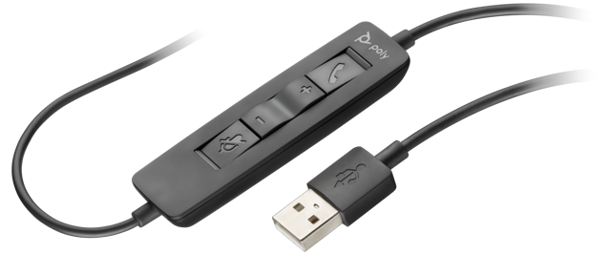
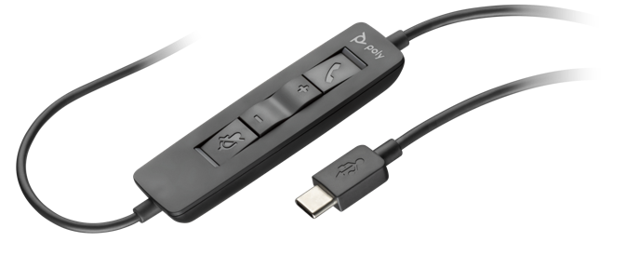
Models to suit all your connection needs
Poly QD
EncorePro 300 Inline
USB A
USB C
EncorePro 310
EncorePro 320
Notes:
To ensure the EncorePro 300 series supports you on your journey to the cloud, there are models available to suit all your connection and wearing needs. Monoaural and binaural (stereo for the USB models) wearing styles give you a choice between 1 or 2 earpieces
The EncorePro 300 will connect to any phone you have, and any existing Plantronics adapter. Chose the QD version for hot-desking or flexible environments where agents change seats daily – we recommend this due to the very long life of the QD (approx. 30000 cycles). For agents with fixed desks and softphones, chose the USB version – both –A and –C models are available.

Slide 8
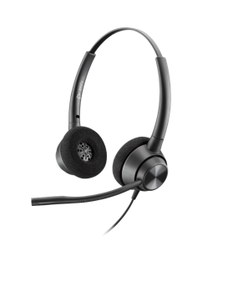
Encorepro family: march 2020
BEST
—
EncorePro 710/720
—
BETTER
EncorePro 530
EncorePro 510/520
EncorePro 540
NEW
GOOD
—
EncorePro 310/320
—
Notes:
Here’s how the family line up looks. Top of the tree is the EncorePro 700 with a stylish design and a host of great features including an extendible mic boom. Next is the EncorePro 500 with aircraft aluminium joints for incredible durability. The EncorePro 300 is our ‘good’ product with a great feature set and fantastic value

Slide 9
Encorepro 300 Series
Simply better conversations
Call privacy
Noise cancelling microphone makes your voice clearer for better conversations
Supervisor coaching**
Simple approach to enable supervisor to listen in and coach agents
Connectivity solutions
Poly QD, USB-A, USB-C
Wideband stereo*
Enhances the audio experience for multimedia training
Acoustic protection
Soundguard, G616, and TWA to protect employee health
Easy wearing style
Ear cushions fold flat so headset can be worn around neck when not on call
Easy to access controls***
Call answer/end, volume up/down and mute (on/off)
High durability
Durable design for all day use–saving you time and money
*USB Binaural models
** QD models
***USB models
Notes:
Let’s look inn detail at some of the features on the EncorePro 300
Call Privacy – noise cancelling microphone to ensure customers do not overhear other conversations in the contact centre
Supervisor coaching – the QD models enable you to use our Y cable, meaning supervisors can sit next to new agents and give them coaching on calls using a really simple and reliable approach
Connectivity solutions – multiple connections options to ensure you can work with any phone
Wideband stereo – with most training now taking place at the desk, wideband stereo gives an enhanced experience
Acoustic protection – protection against acoustic shock and startle incidents, plus against long term sound exposure (exact protection is dependent by model)
Easy wearing style – for those moments when you aren’t on a call, the ear cushions fold flat so the headset is easily worn around the neck
Easy to access controls – in line controls for easy access to volume, mute and answer/end call. No more trying to find the phone screen amongst other applications
High durability – highly durable design based on 50 years of history in the contact centre – saving you time and money

Slide 10
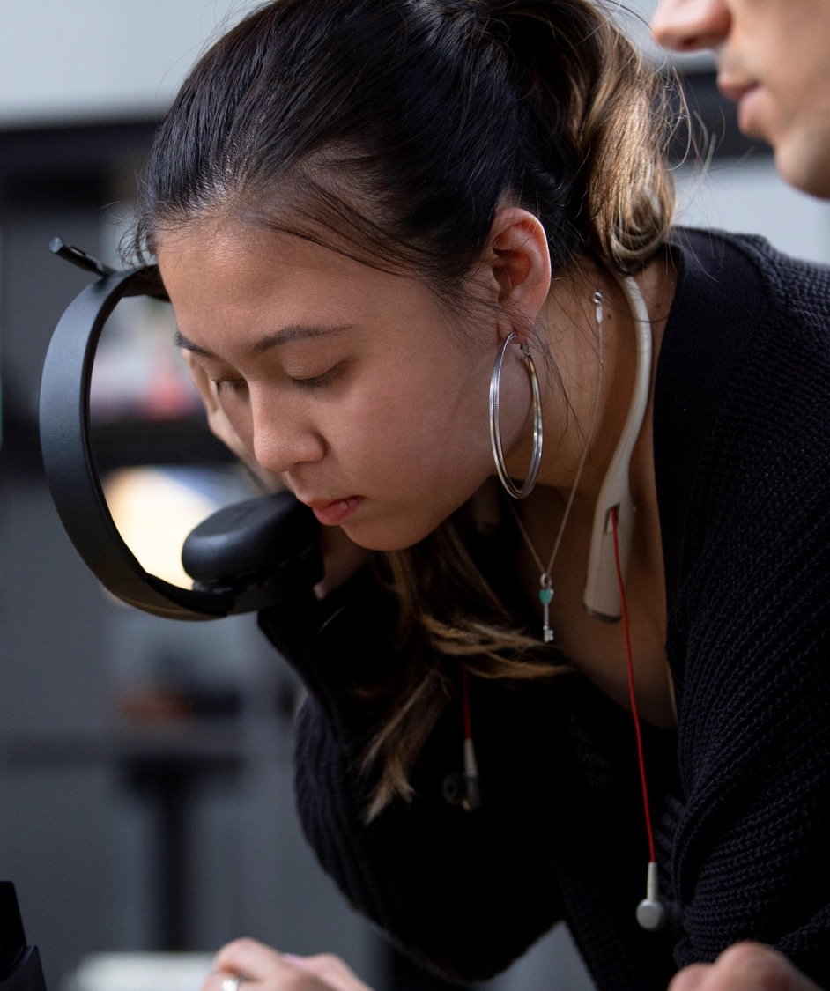
Plantronics Manager Pro*
IT management
Manage and maintain headsets
Keep communication professionals fully equipped and ready to talk
Ensure best voice experience
*A software-as-a-service sold separately
Notes:
Plantronics Manager Pro is an additional subscription-based software-as-a-service that is sold separately. It enables IT managers to monitor, manage and maintain all Savi 8200 Office & UC Series headsets and other headsets centrally.
Plantronics Manager Pro is accessible from any web browser, and your IT department can centrally deploy the latest firmware updates to all Savi 8200 Office and UC Series headsets.
With Plantronics Manager Pro support, you gain insight into every Plantronics headset being used company-wide, including device usage and inventory analysis — all from the cloud.

Slide 11
Plantronics Customer Care
Rapid
Globally consistent
Maximize your investment by taking advantage of our world-class support
Technical assistance
Global direct warranty
Self-service tools
Global supply chain
Reliable
Easy to use
Notes:
As the complexity of supporting the IT needs of any given business grows, so too does the pressure on IT teams. We aim to reduce pressure on our customers’ IT departments.
Technical Assistance: 24/6 phone support in English. Get phone, email and chat support in 14 languages.
Global Direct Warranty: Determine warranty period of your products, using the serial number. Get next-business-day replacement to any registered address. (Certain regions might require longer, depending on logistics coverage.)
Self-Service Tools: Access knowledge base, how-to videos and more.
Global Supply Chain: Rely on Plantronics from start to finish.
The Plantronics Customer Care promise has four components:
Rapid: We are fast. Whether it’s response time, handling time or our warranty replacement service, we know that your time is important and your headsets are business critical.
Reliable: Rely directly on Plantronics to support your devices, no matter which of our partners you purchased from.
Globally consistent: We have one global team and one global process. You can expect the same experience wherever business takes you.
Easy to use: Our warranty tool and contact channels are intuitive and easy to use, so you save valuable time.

Slide 12
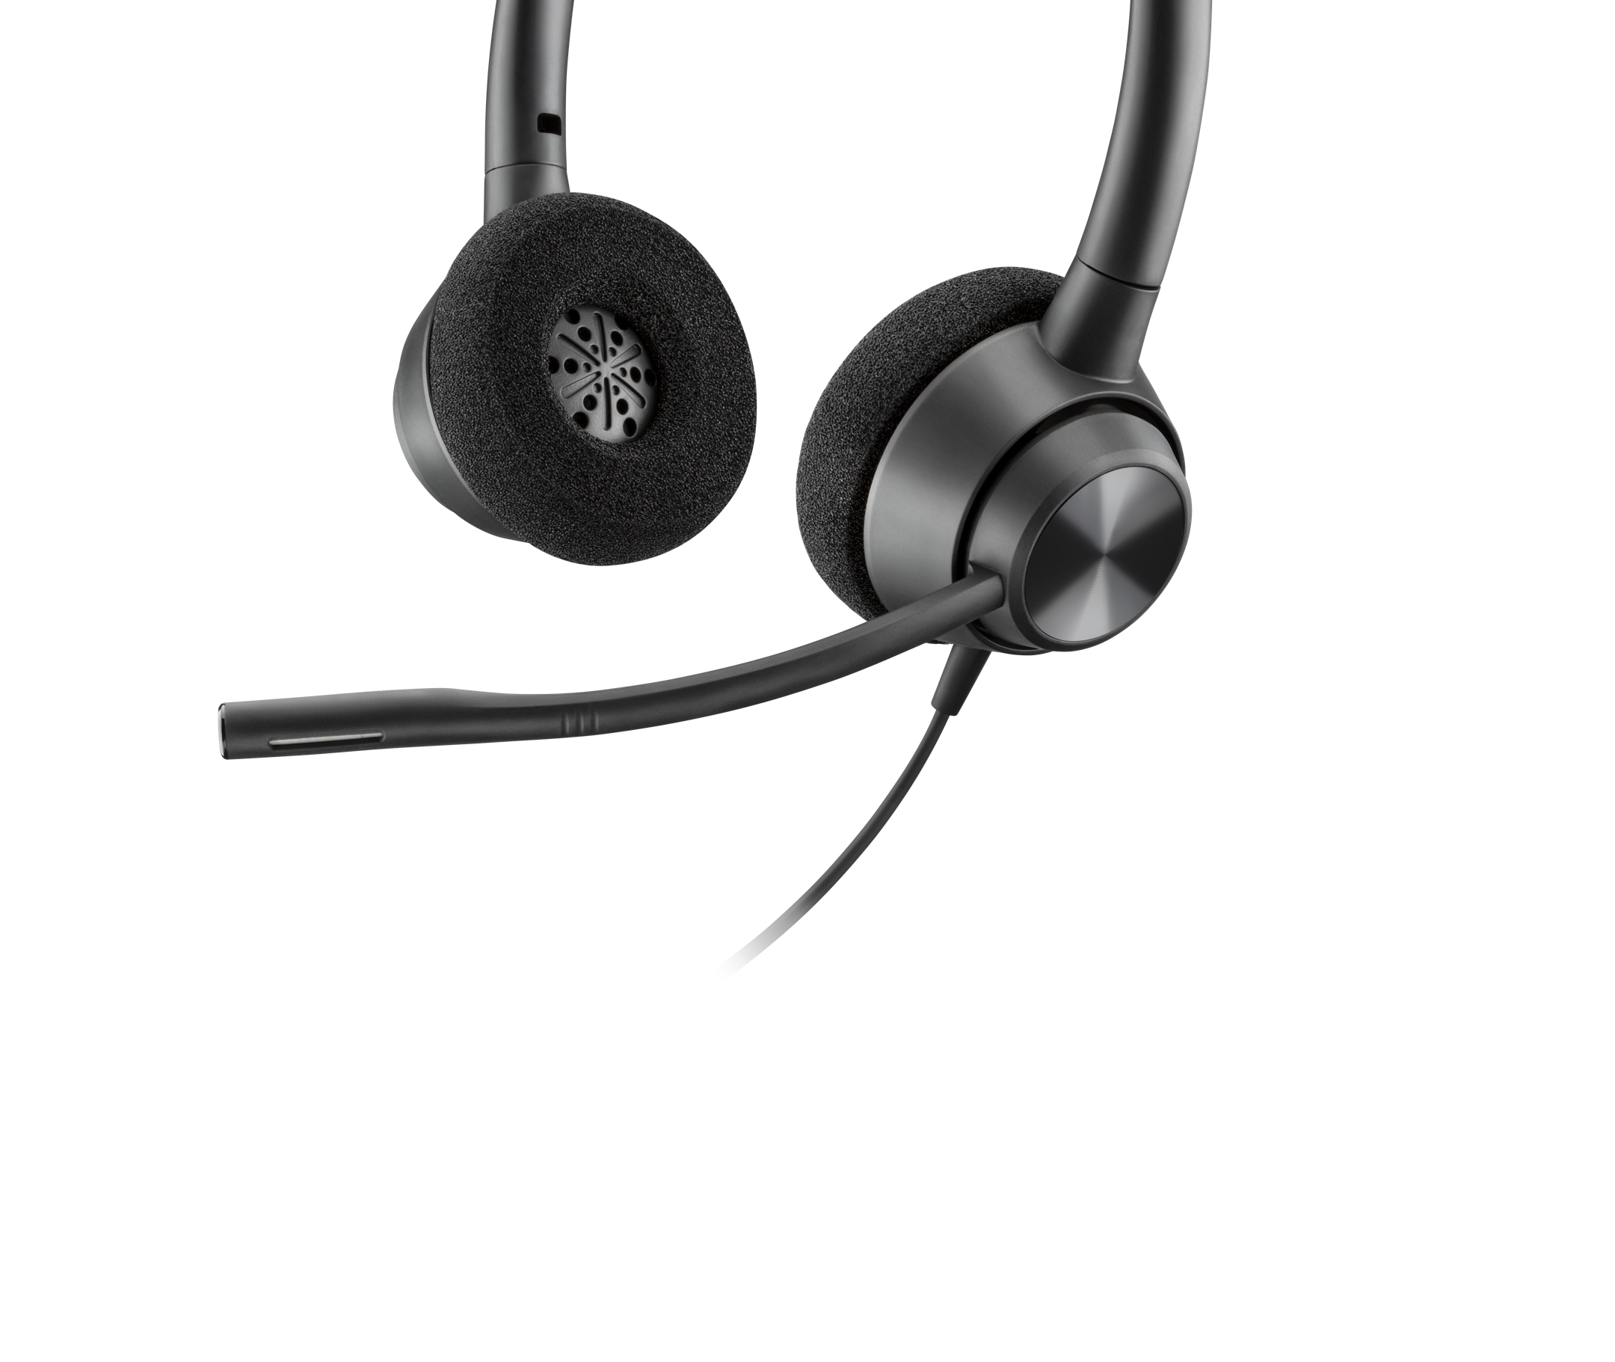
Encorepro 300 series
Comfort.
reliability. value.
Notes:
To summarize, the EncorePro 300 Series offers comfort, reliability, and value – everything your agents need in the contact center to deliver on your promise of better customer experiences

Slide 13
Thank You

